Slide 1

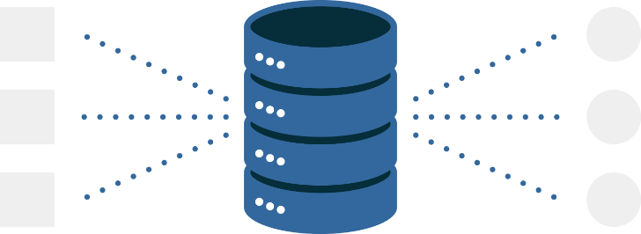
Schemas
Lecture 2
Fahad Maqbool
Department of Computer Science

Slide 2
Agenda
Conceptual Model
Logical Model
Physical Model
Normalization

Slide 3
Conceptual Schema
High-level description of informational needs underlying the design of a database.
Typically includes only the main concepts and the main relationships among them.
A first-cut model, with insufficient detail to build an actual database.

Slide 4

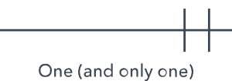
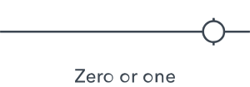



Entity Relationship Diagram
Entity
Attribute
Entity
Attribute
Relationship
Attribute

Slide 5

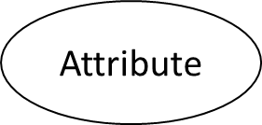
Attribute
Attribute
Attribute

Slide 6
Logical Schema
Structure of the data
Relationships between the various attributes, tables, and entries
Formulates all the constraints that are to be applied to the data

Slide 7
Physical Schema
Data Management
How data is to be represented and stored (files, indices, hashing) in secondary storage
What is hashing?
When to or not to use hashing?

Slide 8
Schemas
Conceptual Schema
Logical Schema
Physical Schema
User
Requirements

Slide 9
Normalization

Slide 10
Normalization
What is normalization?
What are the goals of normalization?
Eliminate redundant data.
Ensure data dependencies make sense.
What is the result of normalization?
What are the levels of normalization?
Always follow purists approach of normalization?
NO

Slide 11
Normalization
Consider a student database system to be developed for a multi-campus university, such that it specializes in one degree program at a campus i.e. BS, MS or PhD.
SID | Degree | Campus | Course | Marks
1 | BS | Islamabad | CS-101 | 30
1 | BS | Islamabad | CS-102 | 20
1 | BS | Islamabad | CS-103 | 40
1 | BS | Islamabad | CS-104 | 20
1 | BS | Islamabad | CS-105 | 10
1 | BS | Islamabad | CS-106 | 10
2 | MS | Lahore | CS-101 | 30
2 | MS | Lahore | CS-102 | 40
3 | MS | Lahore | CS-102 | 20
4 | BS | Islamabad | CS-102 | 20
4 | BS | Islamabad | CS-104 | 30
4 | BS | Islamabad | CS-105 | 40
SID: Student ID
Degree: Registered as BS or MS student
Campus: City where campus is located
Course: Course taken
Marks: Score out of max of 50

Slide 12
Normalization: 1NF
Only contains atomic values, BUT also contains redundant data.
FIRST
SID
Degree
Campus
Course
Marks
1
BS
Islamabad
CS-101
30
1
BS
Islamabad
CS-102
20
1
BS
Islamabad
CS-103
40
1
BS
Islamabad
CS-104
20
1
BS
Islamabad
CS-105
10
1
BS
Islamabad
CS-106
10
2
MS
Lahore
CS-101
30
2
MS
Lahore
CS-102
40
3
MS
Lahore
CS-102
20
4
BS
Islamabad
CS-102
20
4
BS
Islamabad
CS-104
30
4
BS
Islamabad
CS-105
40

Slide 13
Normalization: 1NF
Update anomalies
INSERT. Certain student with SID 5 got admission in a different campus (say) Karachi cannot be added until the student registers for a course.
DELETE. If student graduates and his/her corresponding record is deleted, then all information about that student is lost.
UPDATE. If student migrates from Islamabad campus to Lahore campus (say) SID = 1, then six rows would have to be updated with this new information.

Slide 14
Normalization: 2NF
Every non-key column is fully dependent on the PK
FIRST is in 1NF but not in 2NF because degree and campus are functionally dependent upon only on the column SID of the composite key (SID, course). This can be illustrated by listing the functional dependencies in the table:
SID —> campus, degree
campus —> degree
(SID, Course) —> Marks
SID & Campus are NOT unique
To transform the table FIRST into 2NF we move the columns SID, Degree and Campus to a new table called REGISTRATION. The column SID becomes the primary key of this new table.

Slide 15
Normalization: 2NF
SID | Degree | Campus
1 | BS | Islamabad
2 | MS | Lahore
3 | MS | Lahore
4 | BS | Islamabad
5 | PhD | Peshawar
SID | Course | Marks
1 | CS-101 | 30
1 | CS-102 | 20
1 | CS-103 | 40
1 | CS-104 | 20
1 | CS-105 | 10
1 | CS-106 | 10
2 | CS-101 | 30
2 | CS-102 | 40
3 | CS-102 | 20
4 | CS-102 | 20
4 | CS-104 | 30
4 | CS-105 | 40
REGISTRATION
PERFORMANCE
SID is now a PK
PERFORMANCE in 2NF as (SID, Course) uniquely identify Marks

Slide 16
Normalization: 2NF
Presence of modification anomalies for tables in 2NF. For the table REGISTRATION, they are:
INSERT: Until a student gets registered in a degree program, that program cannot be offered!
DELETE: Deleting any row from REGISTRATION destroys all other facts in the table.
Why there are anomalies?
The table is in 2NF but NOT in 3NF

Slide 17
Normalization: 3NF
All columns must be dependent only on the primary key.
Table PERFORMANCE is already in 3NF. The non-key column, marks, is fully dependent upon the primary key (SID, degree).
REGISTRATION is in 2NF but not in 3NF because it contains a transitive dependency.
A transitive dependency occurs when a non-key column that is a determinant of the primary key is the determinate of other columns.
The concept of a transitive dependency can be illustrated by showing the functional dependencies in REGISTRATION:
REGISTRATION.SID —> REGISTRATION.Degree
REGISTRATION.SID —> REGISTRATION.Campus
REGISTRATION.Campus —> REGISTRATION.Degree
Note that REGISTRATION.Degree is determined both by the primary key SID and the non-key column campus.

Slide 18
Normalization: 3NF
To transform REGISTRATION into 3NF, we create a new table called CAMPUS_DEGREE and move the columns campus and degree into it.
Degree is deleted from the original table, campus is left behind to serve as a foreign key to CAMPUS_DEGREE, and the original table is renamed to STUDENT_CAMPUS to reflect its semantic meaning.

Slide 19
Normalization: 3NF
STUDENT_CAMPUS
SID
Campus
1
Islamabad
REGISTRATION
2
Lahore
SID
Degree
Campus
3
Lahore
1
BS
Islamabad
4
Islamabad
2
MS
Lahore
5
Peshawar
3
MS
Lahore
4
BS
Islamabad
CAMPUS_DEGREE
5
PhD
Peshawar
Campus
Degree
Islamabad
BS
Lahore
MS
Peshawar
PhD

Slide 20
Normalization: 3NF
Removal of anomalies and improvement in queries as follows:
INSERT: Able to first offer a degree program, and then students registering in it.
UPDATE: Migrating students between campuses by changing a single row.
DELETE: Deleting information about a course, without deleting facts about all columns in the record.

Slide 21
Normalization
Conclusions:
Normalization guidelines are cumulative.
Generally a good idea to only ensure 2NF.
3NF is at the cost of simplicity and performance.
There is a 4NF with no multi-valued dependencies.
There is also a 5NF.

